Slide 1

Stage Five Group 2.2

Slide 2
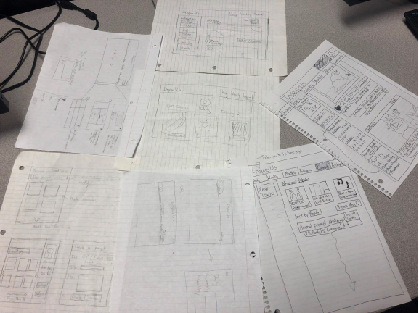
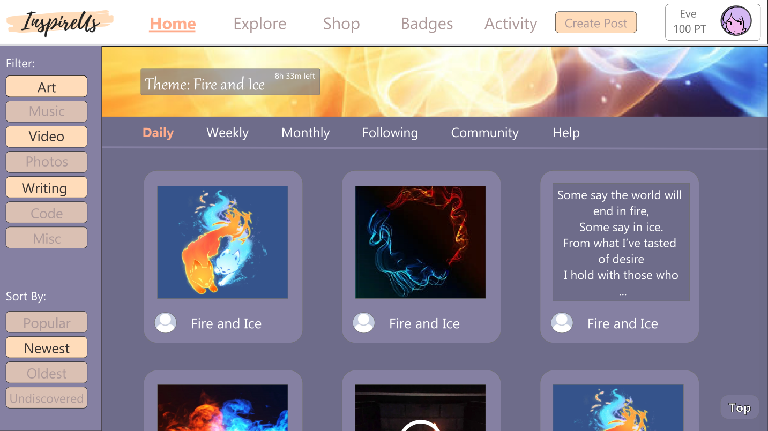
Overview
‘InspireUs’ is a content sharing platform that focuses on a system of creative prompts. The platform will share global prompts with the users and encourage them to create content that shares its theming with the prompts, under a fixed deadline. The platform will support all kinds of content including, but not limited to, art, music, videos, stories, and video games.

Slide 3

Design Problems
Artists, writers, composers, and other types of content creators often run into creative slumps, and struggle to consistently come up with ideas for stuff to work on.
Once a content creator finishes a project, they sometimes have trouble getting their work noticed.

Slide 4
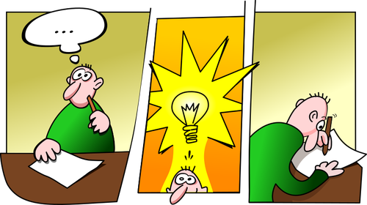
Addressing Design Problems
InspireUs gives abstract prompts with fixed deadlines to help motivate creators
Just browsing other posts on the site can give inspiration too.
Frequently rotating prompts help creators produce content that is more likely to be seen, due to a smaller pool of submissions for individual themes

Slide 5
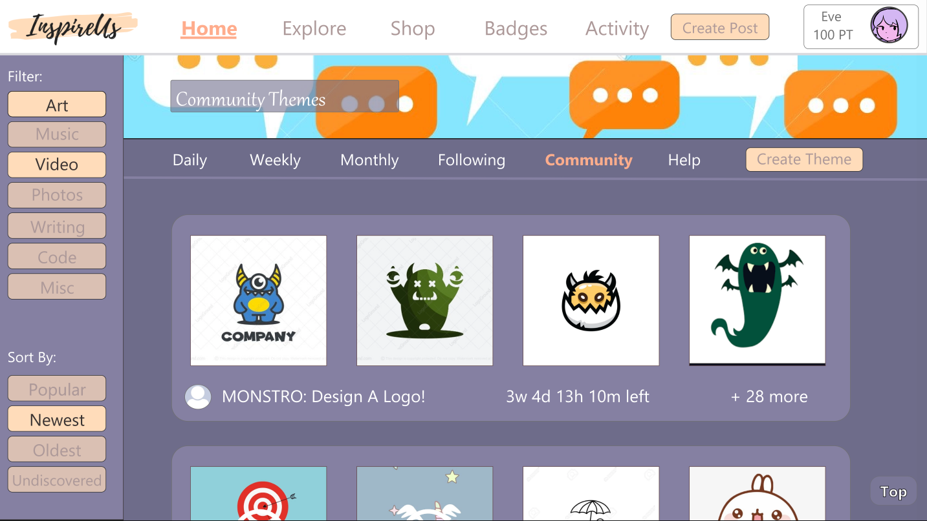
End Users & Stakeholders
Content Creators - Get inspiration, post their content, expose their content to a wider audience, challenge themselves with timed events.
Content Consumers - View and consume content, find and interact with individuals who enjoy similar content.
Companies and Organizations - Scout for talent or potential employees, host creative events.

Slide 6


User Research Methods
Interviews
In-depth discussions with a variety of content creators
More open-ended than surveys
Learned about their experiences and platforms they used
Personas
Characterized different types of users and their needs based on interview results
Different specialties, level of experience and goals

Slide 7
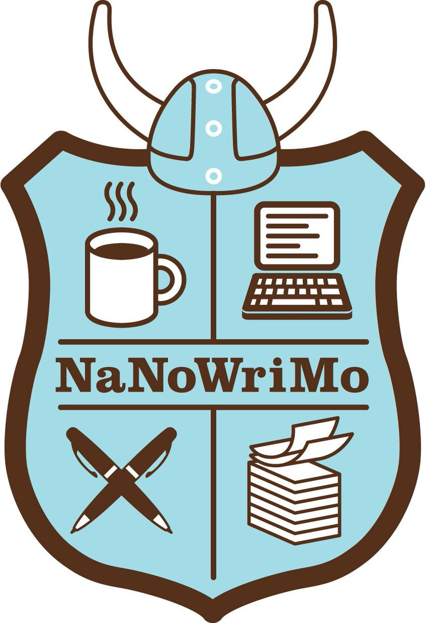


User Research Discoveries
Content creators often go through periods where they find it hard to come up with ideas.
Content creators enjoy participating in timed theme-based events.
Compared to current content sharing platforms, users desire better opportunities to get their work noticed and a better sense of community.
Users often enjoy viewing other people’s content and seeing how multiple different individuals interpret a single concept.

Slide 8
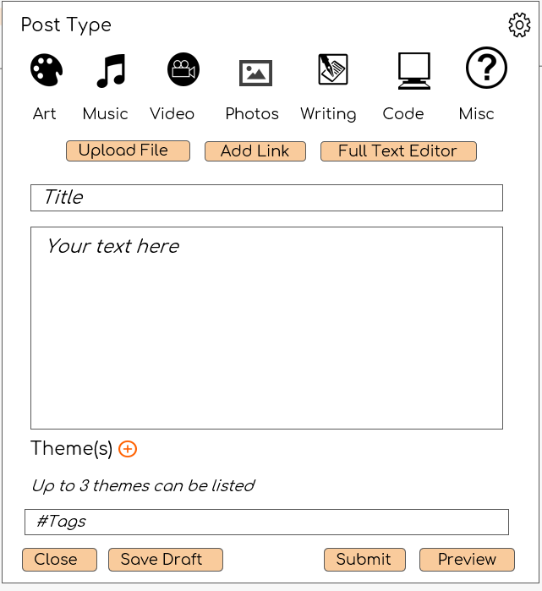
Design Process
We decided early to split prompts into daily, weekly, and monthly categories.
We felt they were the perfect amounts of time to process a prompt and submit content for it, with the longer amount of time allowing for larger projects.
Yearly was considered, but deemed too long of a time period.
First focused on the design for posting, browsing and the profile page as core features

Slide 9
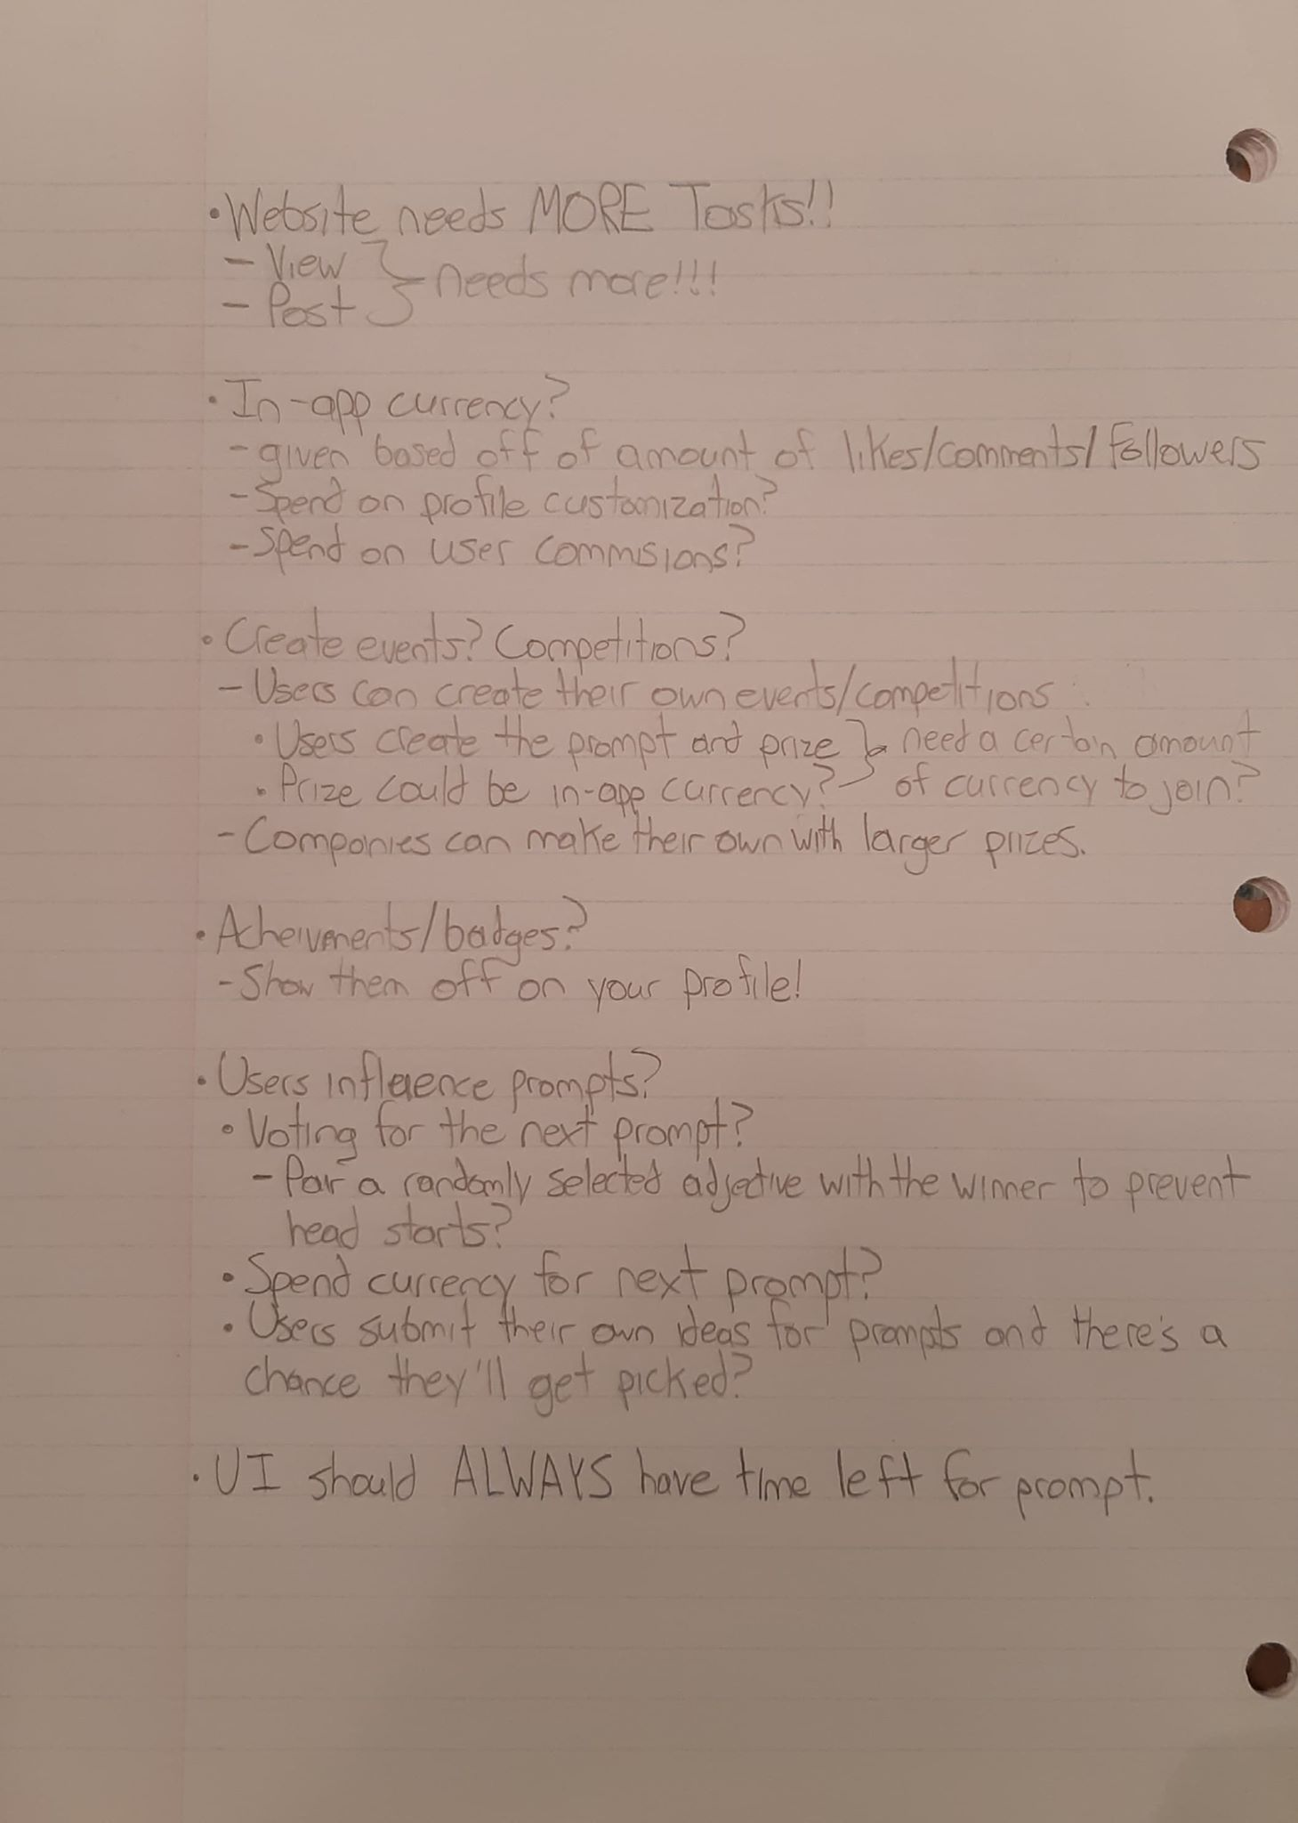
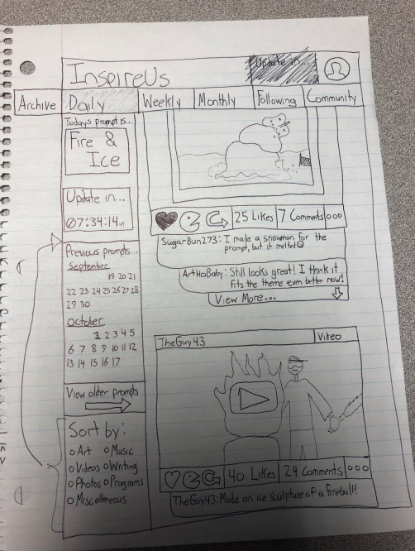
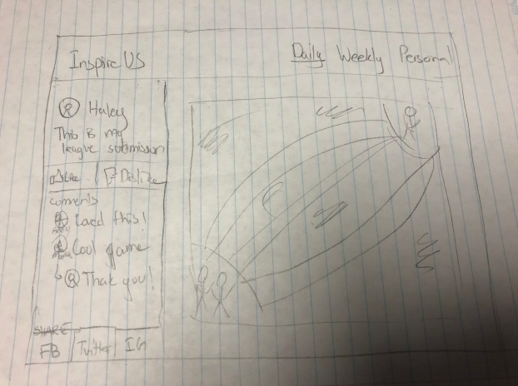
Ideas and Sketches

Slide 10
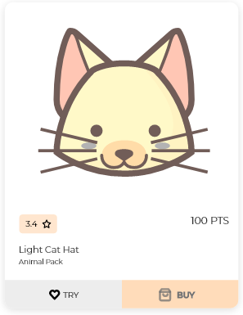
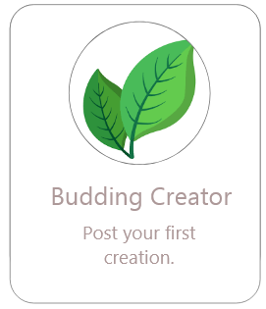
Design Process
Shop and Badges were added to incentivize and reward users for using the platform.
Added after realizing that the platform lacked multiple different ways for users to interact with it.
We considered having ways for users to affect what new prompts would appear on the platform, but we ultimately decided to leave it out of the final submission.
We didn’t see it as a priority over what we already had, and we didn’t want users to discover an upcoming prompt ahead of time and give them an unfair head start.

Slide 11
Heuristic Evaluations
Important issues found were page link errors, and limited user freedom and error prevention when posting
Some misunderstandings and confusion about the concept of ‘themes’/prompts
Initial Prototype lacked Login/Sign Up pages and a Help manual, which would be useful if a user got stuck or to guide new users
Some language used was ambiguous
Some inconsistencies in the UI

Slide 12
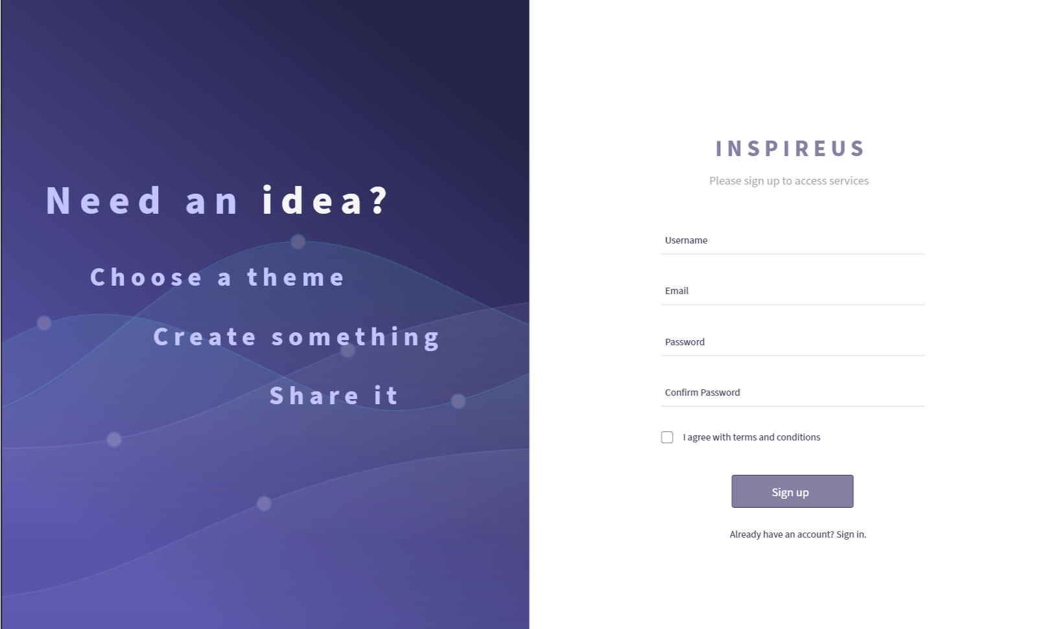
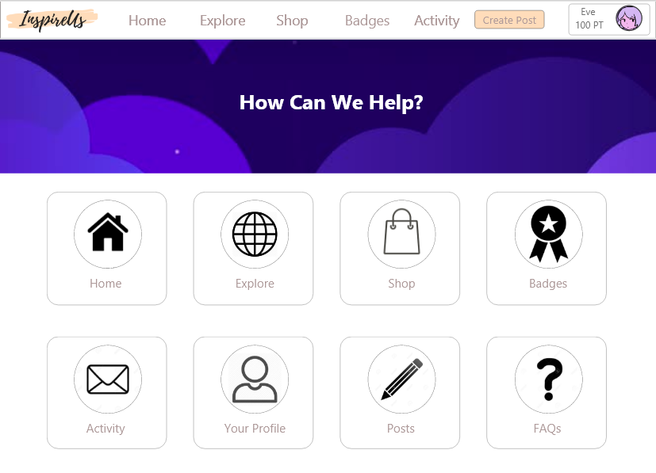
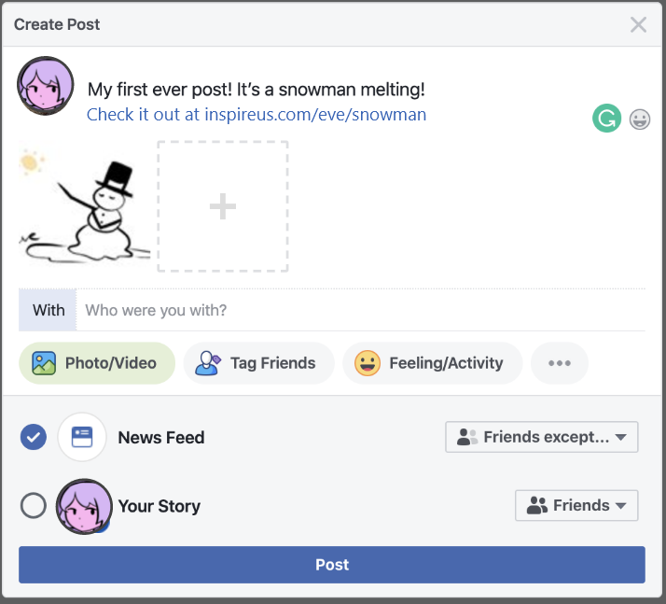
This Iteration
Implemented Changes:
Fixed links and some visual bugs
New login/signup pages clarifying site purpose
New help page for user documentation
Added more undo functionalities
Post sharing to outside sites
Followers tab and FAQ page

Slide 13
The Next Iteration
Future Plans
In-depth implementation of more features, like exploring past posts, profile customization, messaging, detailed post creation with drafts, etc.
Decluttering layout and experimenting more with colour palette
Tutorial for new users
Greater incentives and benefits for creators (eg. theme contests with prizes, custom shop content, commissions…)

Slide 14
Thank you!

